Slide 1


R.A.M.S: Room Attendance Monitoring System Final Presentation– ECE 510
Instructor : Prof. Jafar Saniie
Group Members:
Mario Carvalho
Syed Tauseeq Hussain
Vikrant Rathod
Srinivasa Karri
April 27, 2023

Slide 2
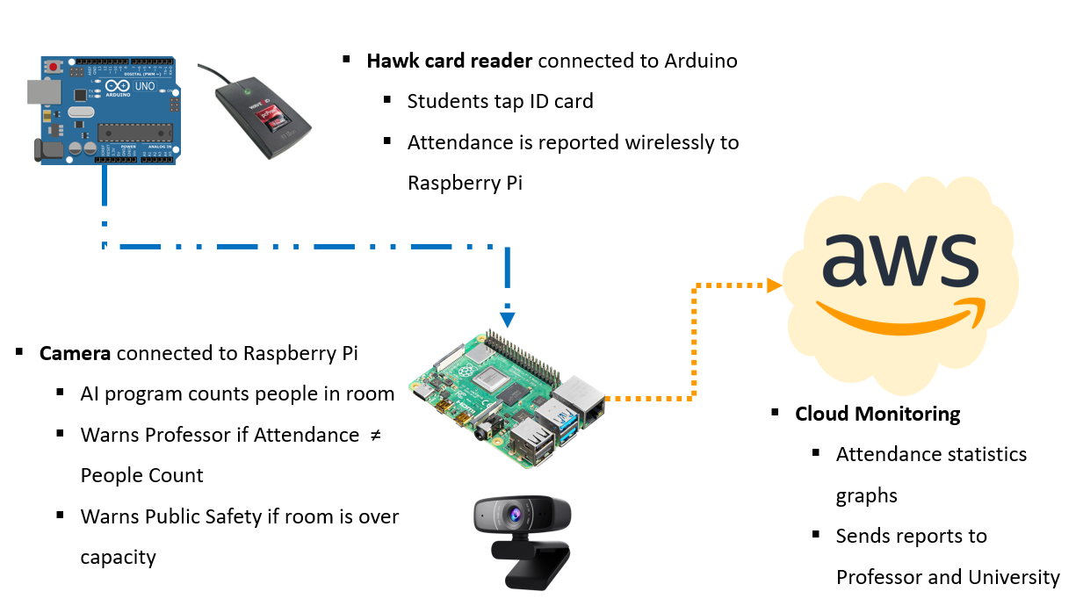
Project Structure & Introduction

Slide 3

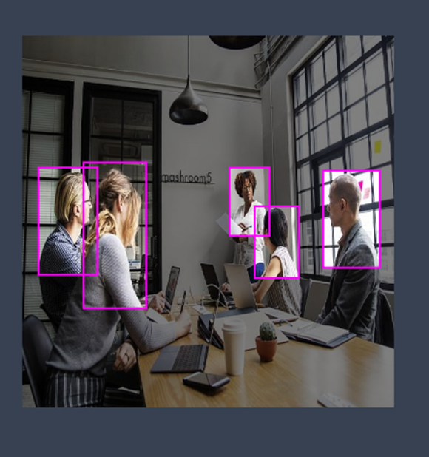

Initial Plan
Data Preprocessing
Manual Annotations
Total images 172
•127 training
•30 validation
•15 testing
No augmentations
Vectorr
Class trained: Person

Slide 4
Facial Recognition (Additional Feature)
Training the classifier based on embeddings
Face detection (First part)
Comparing the computed embeddings with the stored ones
Haar Cascades Algorithm
Training on 100 captured images from different angles

Slide 5

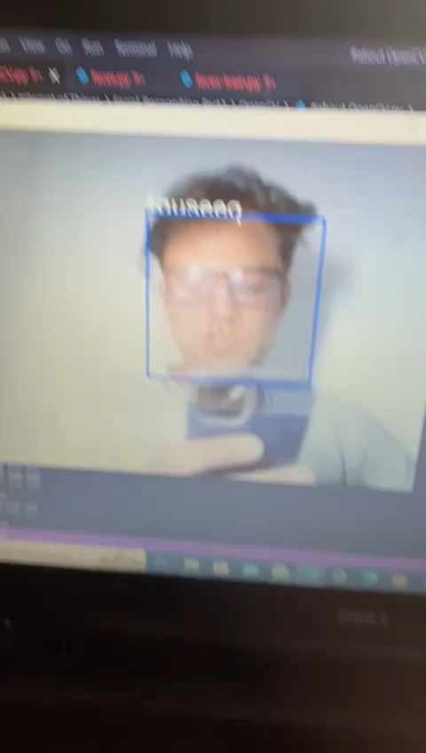
Testing

Slide 6



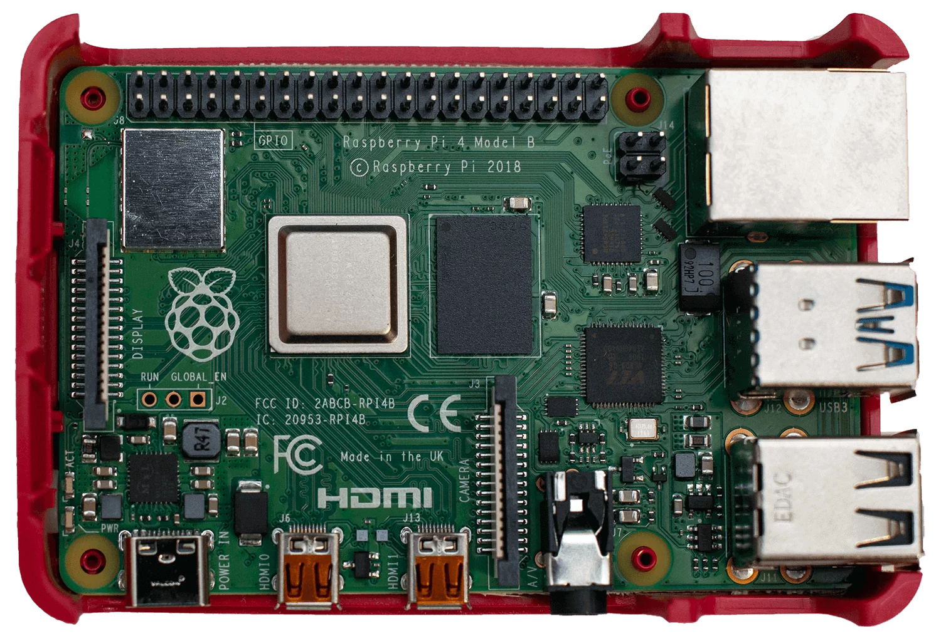
Cloud Monitoring
Our goal is to have a platform for
Plotting attendance data on room–by-room, class-by-class, day-by-day basis
Have a list of students that attended each class
Notify safety authority if i.e room gets over its capacity limit or it detects an individual at am unusual time

Slide 7
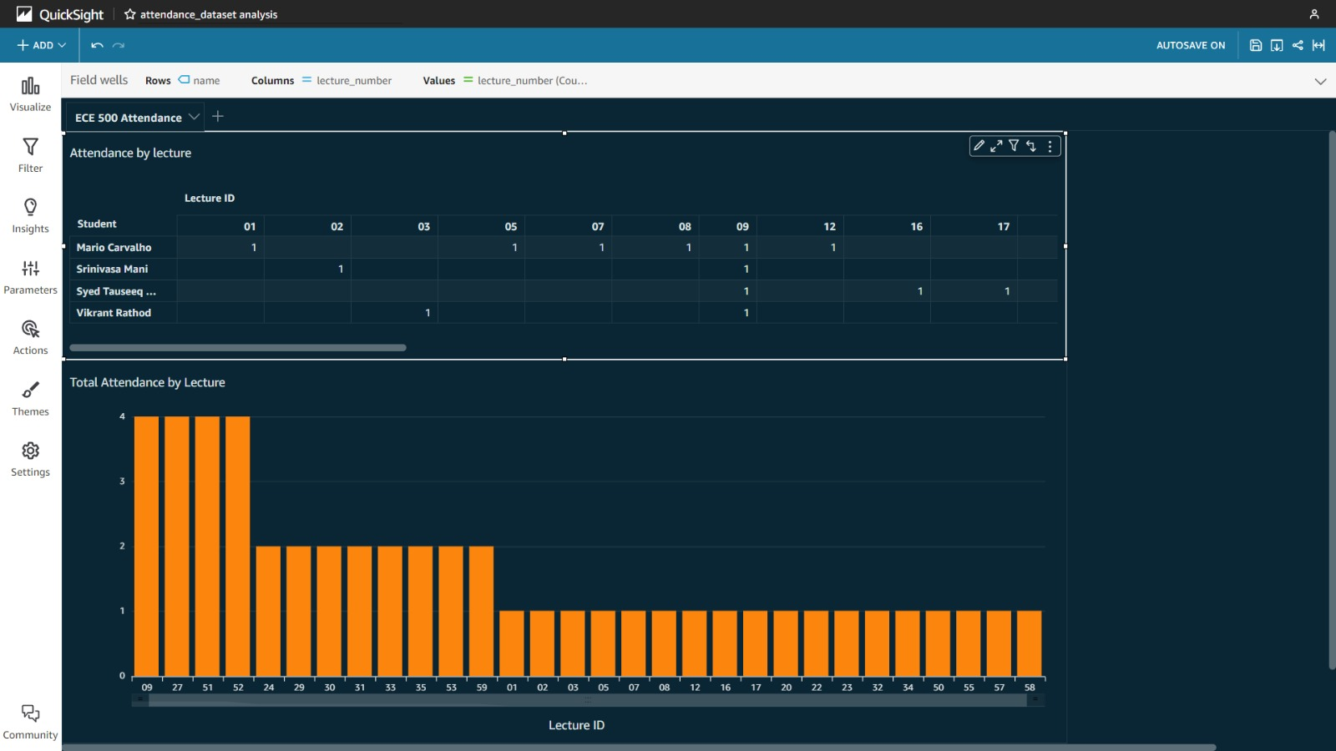
Connecting Raspberry Pi to AWS

Slide 8
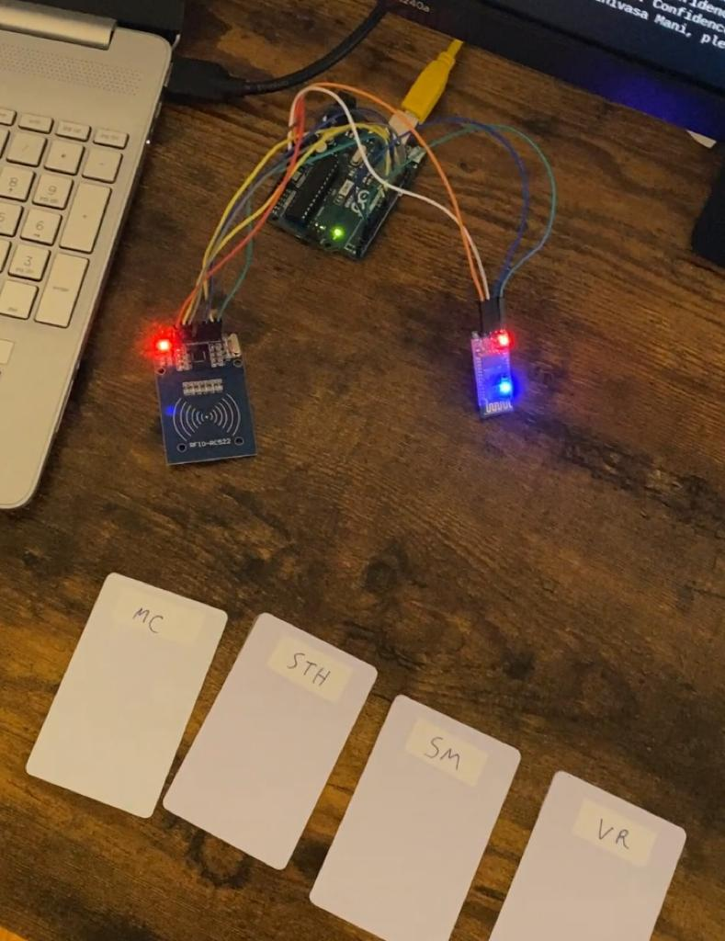
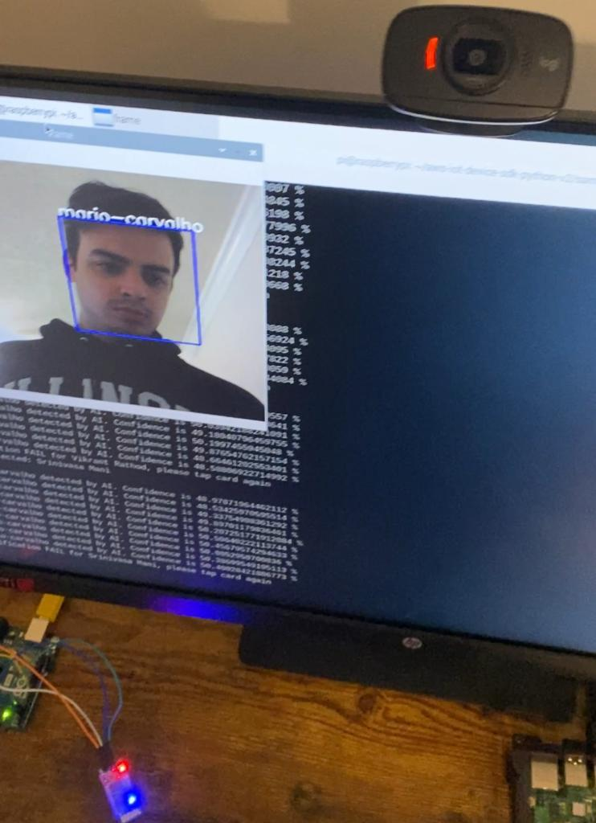

Slide 9
E-Team
C-Team
I-Team
Vikrant
Rathod
Syed Tauseeq Hussain
Mario Carvalho
Srinivasa Karri
Developing the AI vision system for counting number of people
Integrating local data into the cloud, data analysis, and notification generation
Setting up communication involving sensors, microcontrollers, and other hardware components

Slide 10
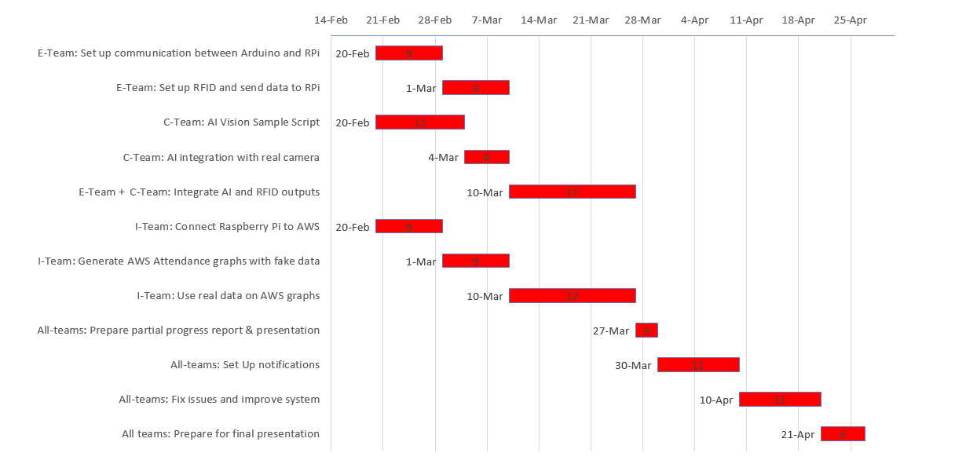
Milestones & Deliverables
j

Slide 11
Conclusion
The connection was successful
system demonstrated the capacity to transmit all required information, such as names, ID, and timestamp.
The communication using MQTT was very reliable.
AWS Quicksight dashboards allowed for doing calculations for all variables obtained from the MQTT communication, and creating a good user interface on Quicksight is one of the main priorities for the remaining weeks of this project
Facial Recognition running

Slide 12
Challenges
Making AI more reliable
Making the communication between Arduino, Raspberry PI, and AWS faster

Slide 13
References
https://realpython.com/python-send-email/web
https://www.geeksforgeeks.org/python-web-app-to-send-push-notification-to- your-phone/
https://www.hackster.io/kela910512/win10-login-via-mfrc522-hc06-oled-hcsr04- android-security-6e9e9e
https://arducam.com/docs/cameras-for-raspberry-pi/ptz-camera
https://github.com/ArduCAM/PTZ-Camera-Controller
https://www.digikey.com/en/maker/blogs/2021/how-to-control-servo-motors- with-a-raspberry-pi
https://towardsdatascience.com/how-to-train-a-custom-object-detection-model- with-yolo-v5-917e9ce13208
https://lastminuteengineers.com/how-rfid-works-rc522-arduino-tutorial/
https://www.kaggle.com/code/ultralytics/yolov5/notebook
https://www.youtube.com/watch?v=zfiSAzpy9NM
https://lastminuteengineers.com/how-rfid-works-rc522-arduino-tutorial/
https://mailtrap.io/blog/amazon-sns-guide/
https://colab.research.google.com/drive/1rrj8tuAttPlPlyAwgYd72EqcfQNS0KHy#scrollTo=eaFNnxLJbq4J
https://us-east-2.console.aws.amazon.com/iotsitewise/home?region=us-east-2#
https://us-east-2.console.aws.amazon.com/iotevents/home?region=us-east-2# https://mqtt.org/

Slide 14




Thank you

